Slide 1
Introduction to text mining
Pre-processing & Vector Space Model
Ayoub Bagheri

Slide 2
Outline
Text mining
Pre-processing text data
Vector space model
Bag-of-Words
Word embedding (afternoon)

Slide 3
Introduction

Slide 4

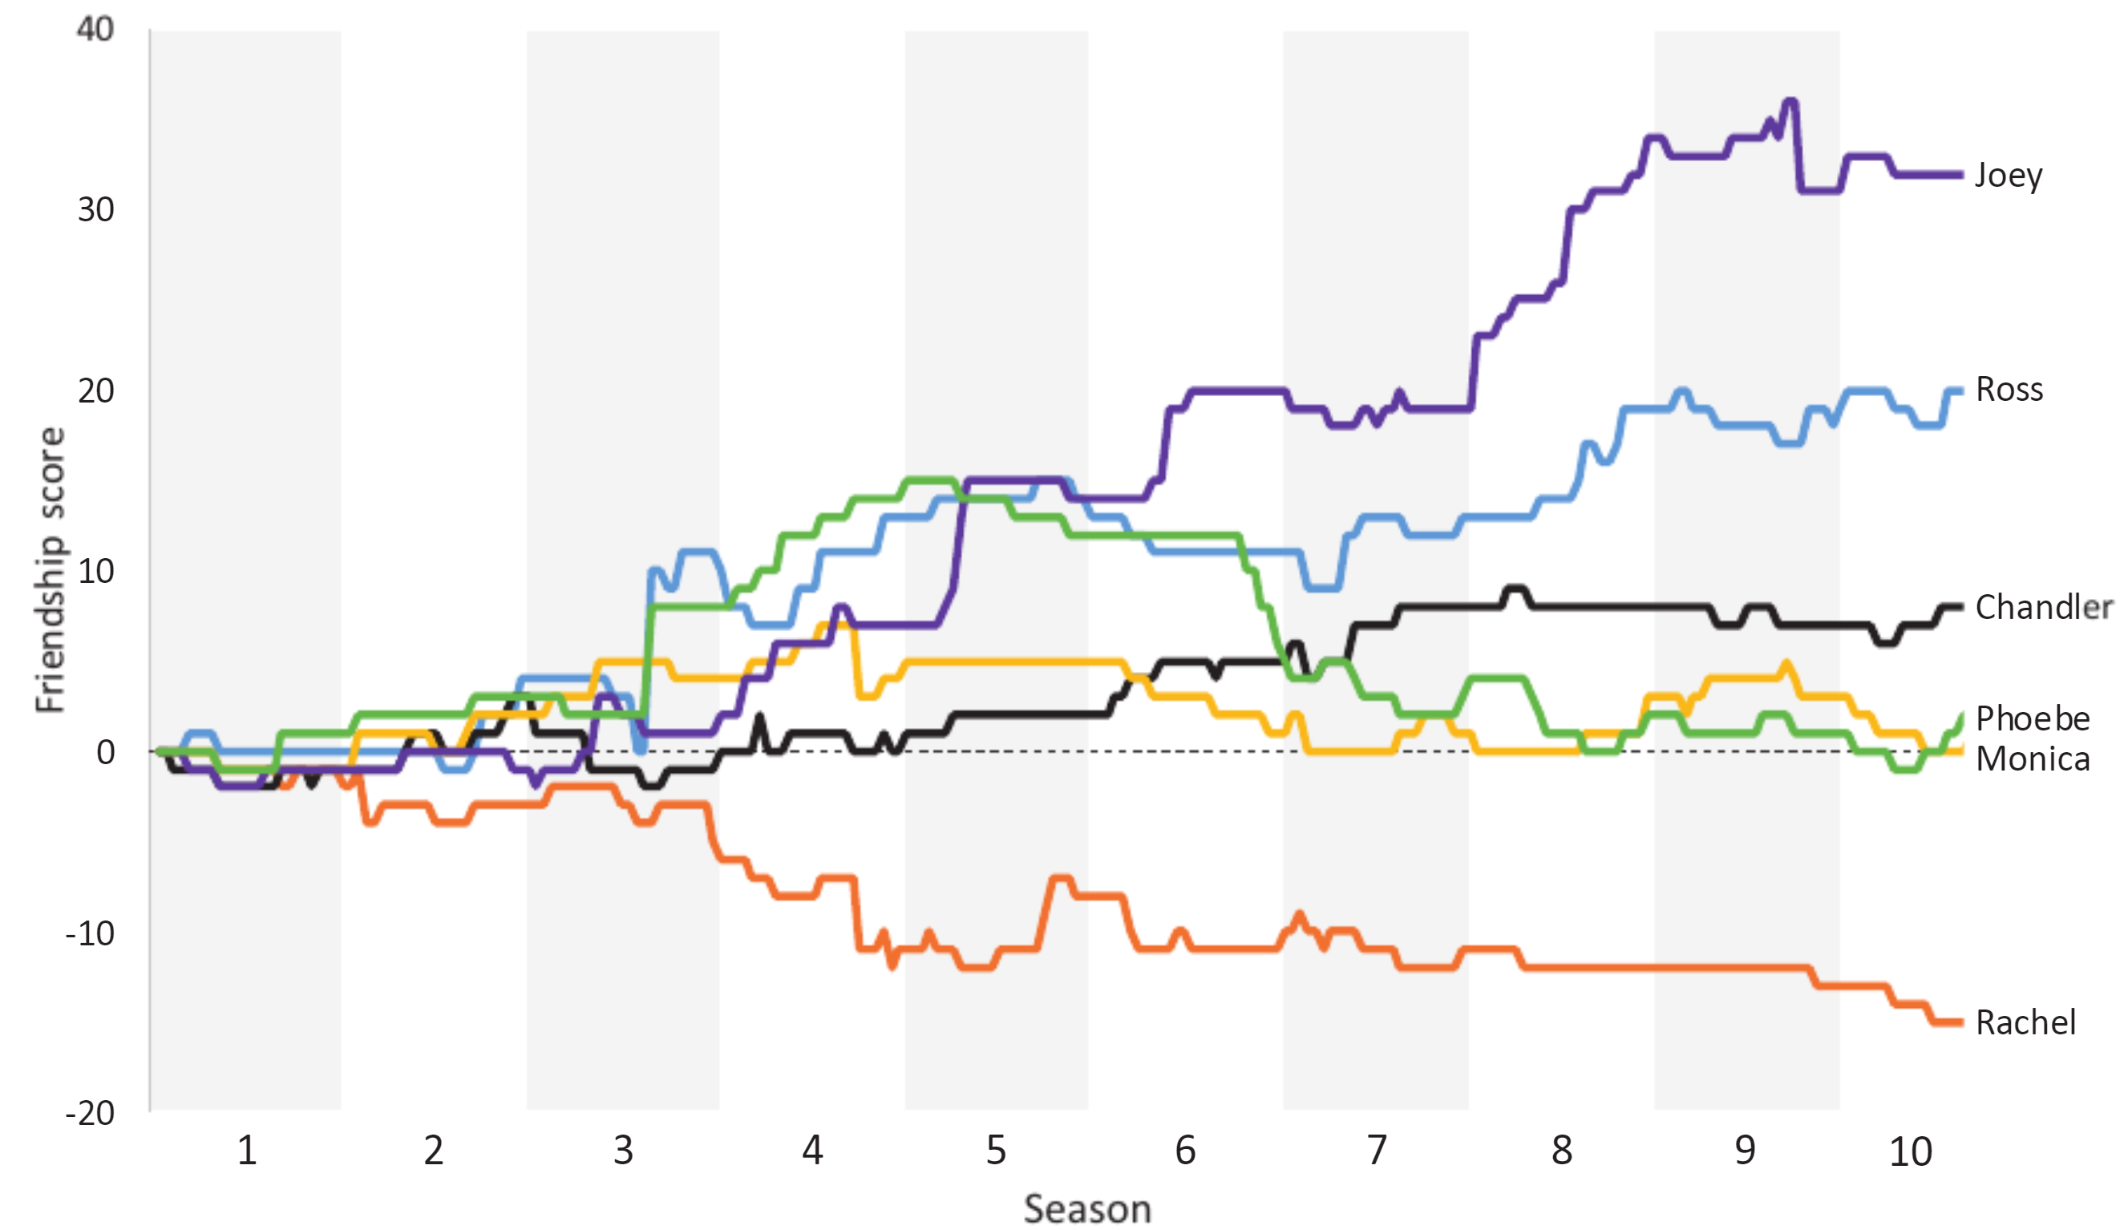
Who was the best Friend?
https://rss.onlinelibrary.wiley.com/doi/epdf/10.1111/1740-9713.01574

Slide 5
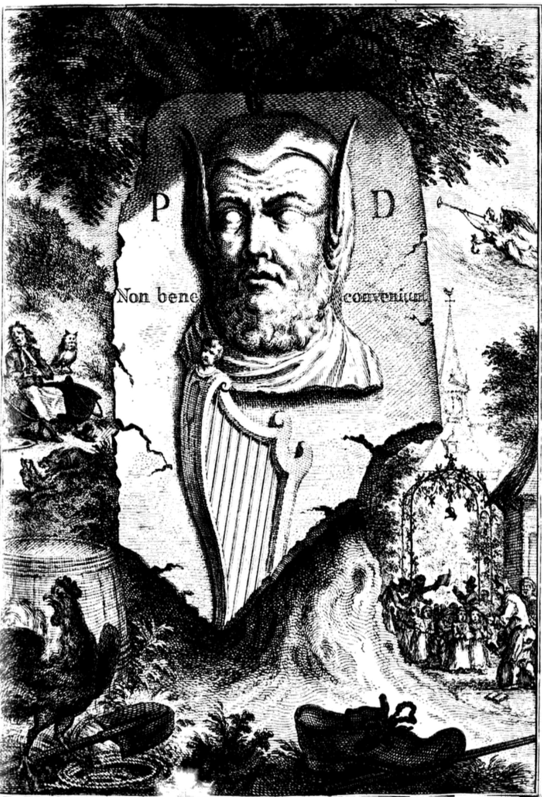
Did a poet with donkey ears write the oldest anthem in the world?
https://dh2017.adho.org/abstracts/079/079.pdf

Slide 6
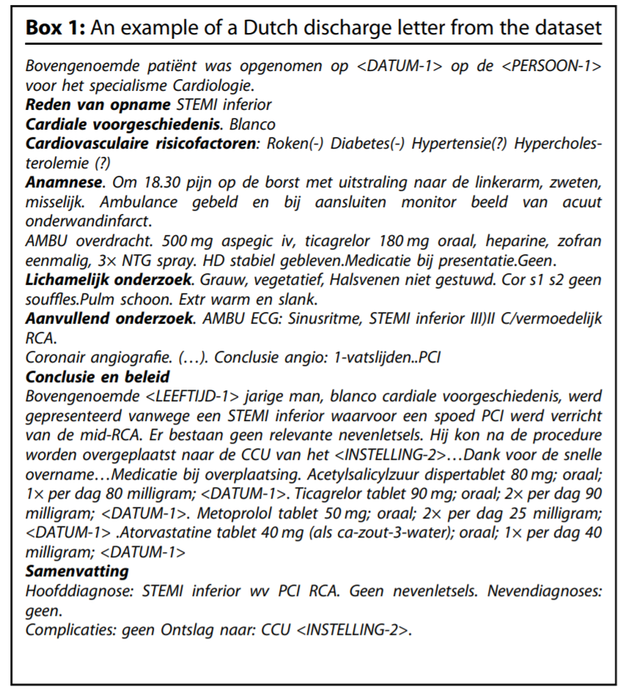
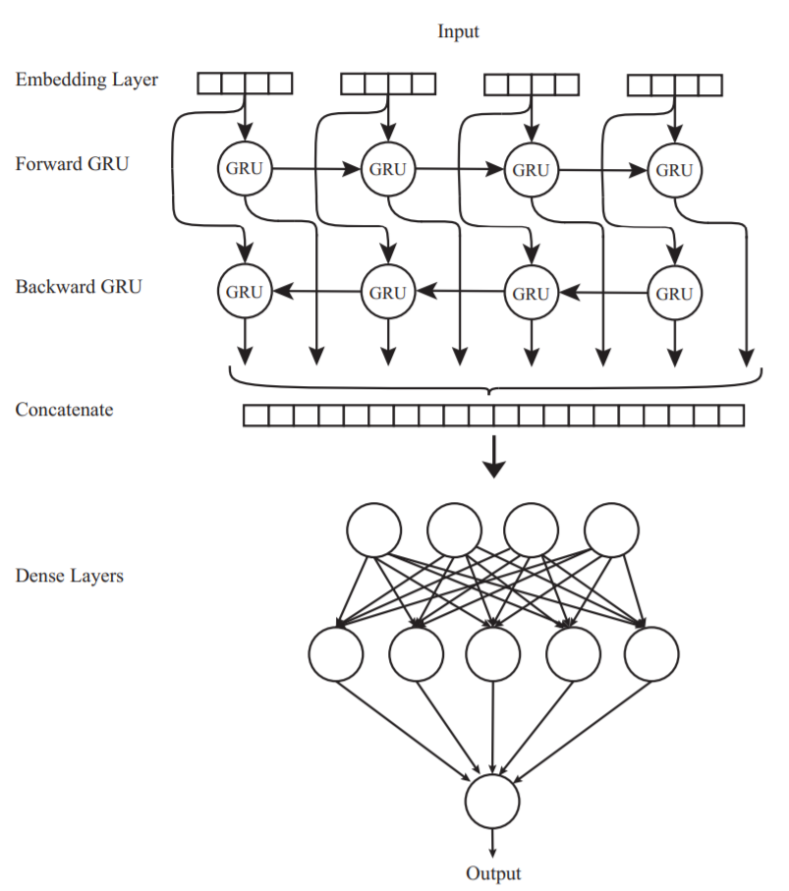
Automatic detection of ICD10 codes in cardiology discharge letters
https://www.nature.com/articles/s41746-021-00404-9

Slide 7
Text mining
“The discovery by computer of new, previously unknown information, by automatically extracting information from different written resources”, Hearst (1999).
Text mining is about looking for patterns in text, in a similar way that data mining can be loosely described as looking for patterns in data.
Text mining describes a set of linguistic, statistical, and machine learning techniques that model and structure the information content of textual sources. (Wikipedia)

Slide 8
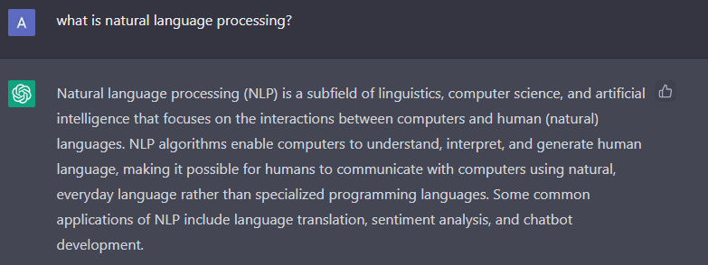
ChatGPT
Notes:
Let’s ask from the ChatGPT (the new AI hype since the last couple of weeks), what is actually NLP?

Slide 9
Why text mining?
Text data is everywhere, websites (e.g., news), social media (e.g., twitter), databases (e.g., doctors’ notes), digital scans of printed materials, …
A lot of world’s data is in unstructured text format
Applications in industry: search, machine translation, sentiment analysis, question answering, …
Applications in science: cognitive modeling, understanding bias in language, automated systematic literature reviews, …

Slide 10
High dimensional data
All possible words & phrases
Complex & subtle relationships in text
”Jumbo merges with Hema”
Ambiguity & context sensitivity
“Jumbo is bought by Hema”
car = automobile = vehicle
kapsalon (hairdresser) or kapsalon (fast food)
Homographs: same words can mean different things
Bat (sports, animal, …)
Synonyms
Misspellings
Abbreviations
Negations
Spelling variations
LANGUAGE!
Notes:
There are many challenges with the unstructured text data, here you see some of them!

Slide 11
Pre-processing Text Data

Slide 12
Text preprocessing
is an approach for cleaning and noise removal of text data.
brings your text into a form that is analyzable for your task.
transforms text into a more digestible form so that machine learning algorithms can perform better.

Slide 13
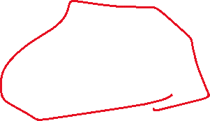



Why?
Dimensionality
Memory allocation
Performance

Slide 14
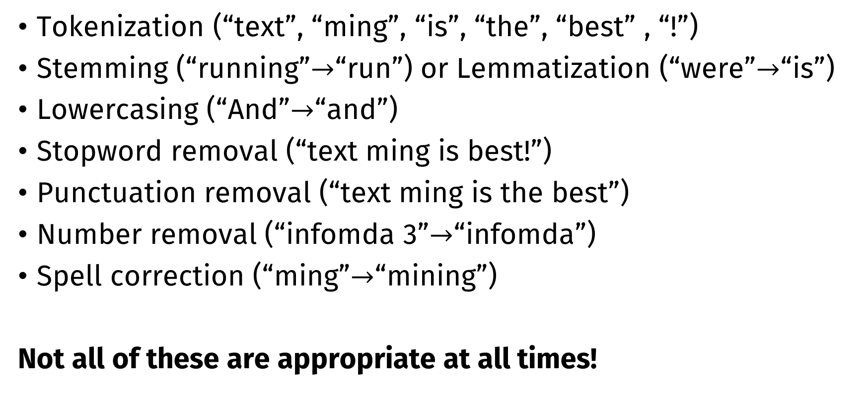
Typical steps
Tokenization (“text”, “ming”, “is”, “the”, “best” , “!”)
Stemming (“running”$→$“run”) or Lemmatization (“were”$→$“is”)
Lowercasing (“And”$→$“and”)
Stopword removal (“text ming is best!”)
Punctuation removal (“text ming is the best”)
Number removal (“infomda 3”$→$“infomda”)
Spell correction (“ming”$→$“mining”)
Not all of these are appropriate at all times!

Slide 15
Example
Text mining is to identify useful information.
Tokenization
‘Text’, ‘mining’, ‘is’, ‘to’, ‘identify’, ‘useful’, ‘information’, ‘.’
Stemming
‘text’, ‘mine’, ‘is’, ‘to’, ‘identify’, ‘use’, ‘inform’, ‘.’
Bigrams
‘text mine’, ‘mine is’, ‘is to’, ‘to identify’, ‘identify use’, ‘use inform’, ‘inform .’
Stopwords & punctuations
‘text mine’, ‘to identify’, ‘identify use’, ‘use inform’
Vectorization
Vector Space Model

Slide 16
Vector Space Model

Slide 17
Basic idea
Text is “unstructured data”
How do we get to something structured that we can compute with?
Text must be represented somehow
Represent the text as something that makes sense to a computer

Slide 18
Vector space model
A vector space is a collection of vectors
Represent documents by concept vectors
Each concept defines one dimension
k concepts define a high-dimensional space
Element of vector corresponds to concept weight

Slide 19
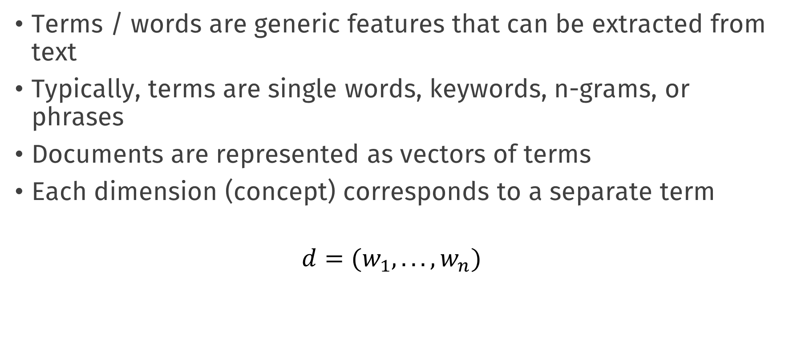
Vector space model
Terms / words are generic features that can be extracted from text
Typically, terms are single words, keywords, n-grams, or phrases
Documents are represented as vectors of terms
Each dimension (concept) corresponds to a separate term
$$d=(w_{1},...,w_{n})$$

Slide 20
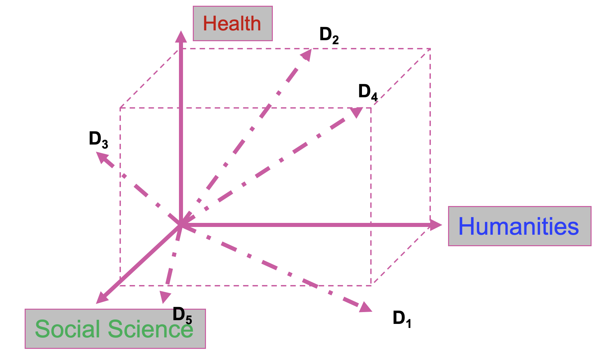






An illustration

Slide 21
Vectorization
The process of converting text into numbers is called Vectorization
Distance between the vectors in this concept space
Relationship among documents

Slide 22





VSM representations
Bag-of-Words
TF, TFiDF
High Dimensional, Sparse
Topics
Topic modeling, Clustering
Low Dimensional
Word Embeddings
W2Vec, fasttext, transformers
Dense representation,
Distributional hypothesis

Slide 23
Bag-of-Words
Terms are words (more generally we can use n-grams)
Weights are number of occurrences of the terms in the document
Binary
Term Frequency (TF)
Term Frequency inverse Document Frequency (TFiDF)

Slide 24
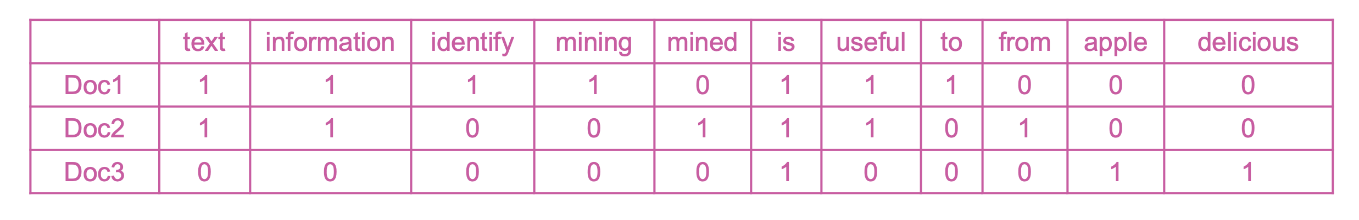
Example
Doc1: Text mining is to identify useful information.
Doc2: Useful information is mined from text.
Doc3: Apple is delicious.
Document-Term matrix (DTM):

Slide 25
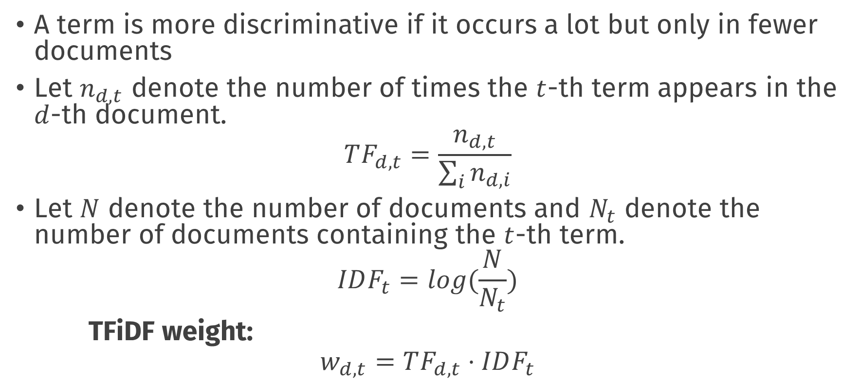
TFiDF
A term is more discriminative if it occurs a lot but only in fewer documents
Let $n_{d,t}$ denote the number of times the $t$-th term appears in the $d$-th document.
$$TF_{d,t}=\frac{n_{d,t}}{\sum_{i}^{​}{n_{d,i}}}$$
Let $N$ denote the number of documents and $N_{t}$ denote the number of documents containing the $t$-th term.
$$IDF_{t}=log(\frac{N}{N_{t}})$$
TFiDF weight:
$$w_{d,t}=TF_{d,t}⋅IDF_{t}$$

Slide 26
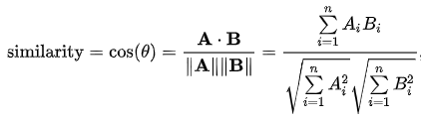
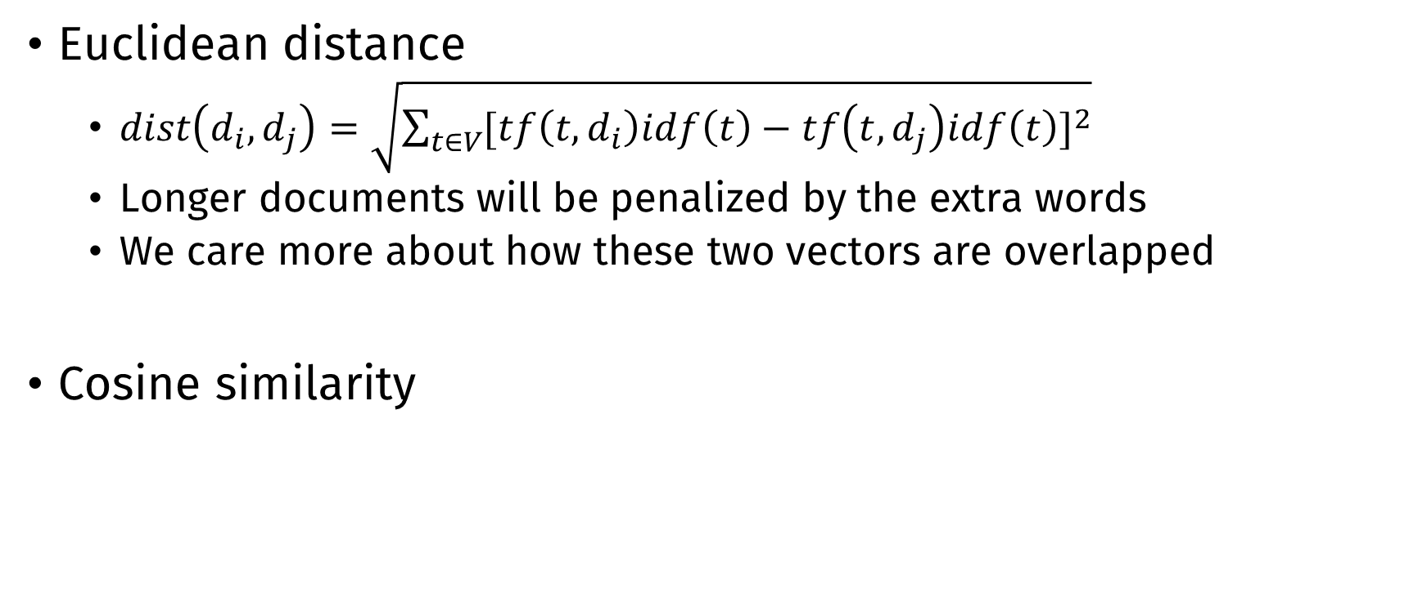
Similarity metric
Euclidean distance
$dist\left(d_{i},d_{j}\right)=\sqrt{\sum_{t∈V}{{[tf\left(t,d_{i}\right)idf\left(t\right)−tf\left(t,d_{j}\right)idf\left(t\right)]}^{2}}}$
Longer documents will be penalized by the extra words
We care more about how these two vectors are overlapped
Cosine similarity

Slide 27
Text data are High Dimensional!

Slide 28

Terminology
Corpus: is a large and structured set of texts
Stop words: words which are filtered out before or after processing of natural language data (text)
Unstructured text: information that either does not have a pre-defined data model or is not organized in a pre-defined manner.
Tokenizing: process of breaking a stream of text up into words, phrases, symbols, or other meaningful elements called tokens (see also lexical analysis)
Natural language processing: field of computer science, artificial intelligence, and linguistics concerned with the interactions between computers and human (natural) languages
Term document (or document term) matrix: is a mathematical matrix that describes the frequency of terms that occur in a collection of documents
Supervised learning: s the machine learning task of inferring a function from labeled training data
Unsupervised learning: find hidden structure in unlabeled data
Stemming: the process for reducing inflected (or sometimes derived) words to their word stem, base or root form—generally a written word form

Slide 29
Practical
Pre-processing and document-term matrices.

Slide 30
Questions?

